Slide 1
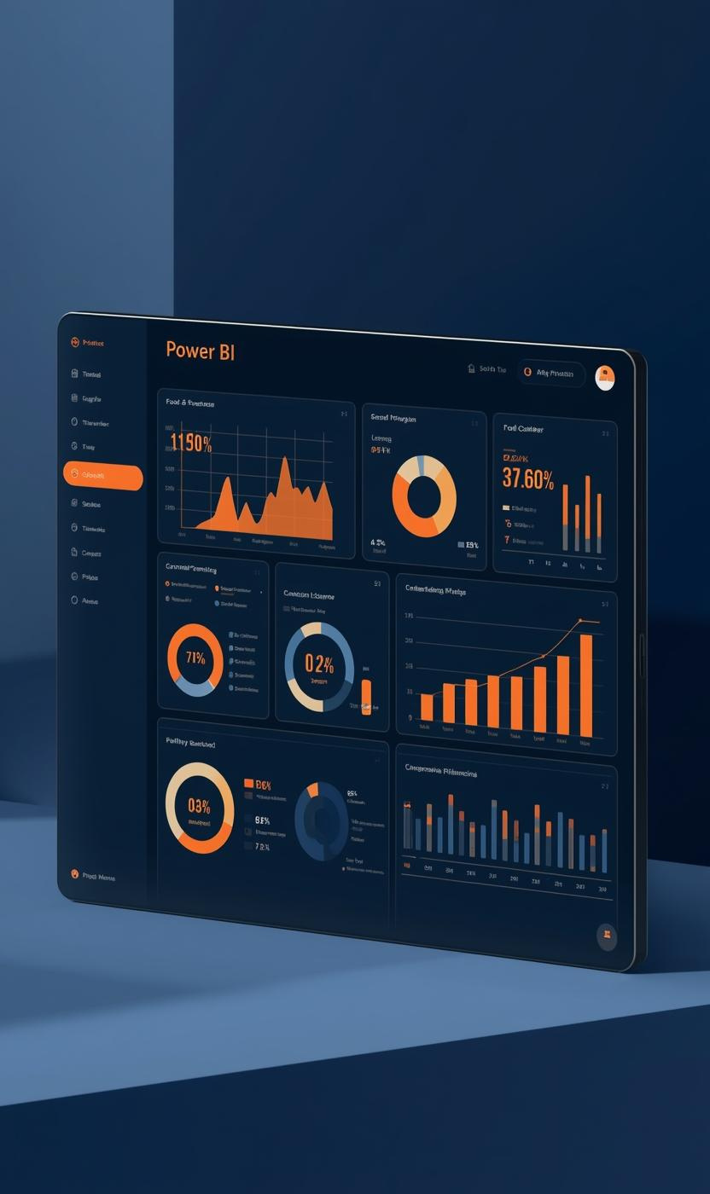

Food Trends: Understanding Customer Preferences in the Food Business

Slide 2
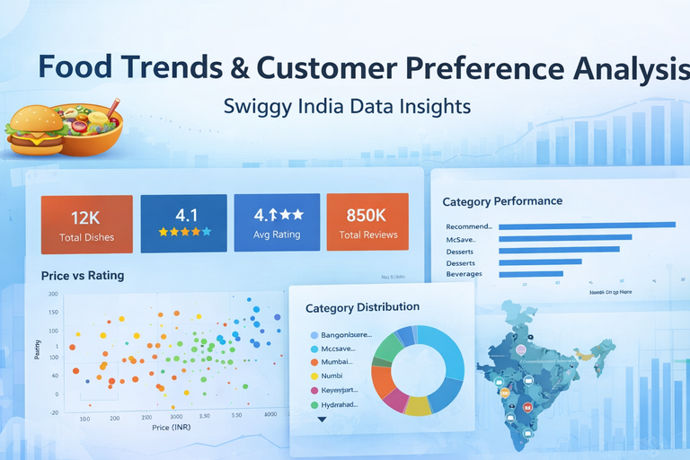
Project Overview
OBJECTIVE
The objective is to analyze customer preferences within food-tech data, enhancing product relevance and strategic business decisions.
The goal of this project was to:
Understand which products perform best
Analyze how pricing affects customer satisfaction
Measure customer sentiment
Identify high-performing and underperforming dishes
Provide data-driven business recommendations
IMPORTANCE
Understanding food trends is critical for effective pricing, product strategy, and retaining customers in a competitive marketplace.

Slide 3

Problem Statement
In the rapidly growing food-tech industry, platforms like Swiggy host thousands of restaurants and menu items, generating massive volumes of customer data in the form of ratings, pricing, and engagement metrics. However, raw data alone does not provide actionable insights. The key challenge is to analyze this large dataset to understand customer preferences, identify high-performing and underperforming products, evaluate the impact of pricing on satisfaction, and measure overall customer sentiment. This project aims to transform raw menu and review data into meaningful business intelligence through data cleaning, modeling, visualization, and sentiment analysis, enabling data-driven decision-making for menu optimization, pricing strategy, and customer satisfaction improvement.

Slide 4
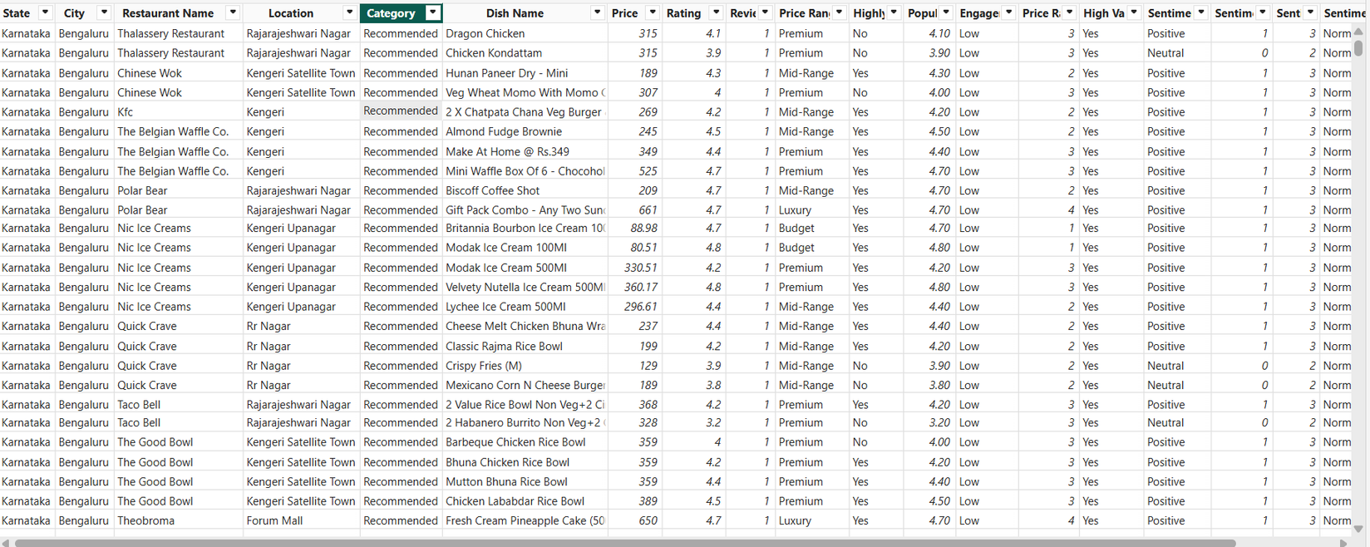
Dataset Overview

Slide 5
Dataset : Swiggy All Menus – India
DATASET DESCRIPTION
The dataset used for this project is the “Swiggy All Menus – India” dataset, which contains detailed information about restaurant menu items across India, primarily focused on Bengaluru, Karnataka. The dataset consists of over 197,000 records and 9 columns, where each row represents a unique dish offered by a restaurant. It includes both categorical and numerical attributes such as State, City, Restaurant Name, Location, Category, Dish Name, Price (INR), Rating (on a 0–5 scale), and Rating Count. This dataset enables comprehensive analysis of customer preferences, pricing strategies, engagement levels, and sentiment patterns. Its large size and diverse attributes make it suitable for business intelligence, product performance analysis, and sentiment-based customer behavior modeling.
KEY FIELDS
Key fields include Price, Rating, Review Count, and Category, enabling a comprehensive analysis of consumer trends and food preferences.

Slide 6
Data Cleaning Process
DATA CLEANING STEPS
DATA MODELING & FEATURE ENGINEERING
Corrected data types (text & numeric validation)
Removed null values
Filtered unrated dishes (Rating = 0)
Removed duplicates
Trimmed and standardized text values
Standardized category formatting
Created sorted order columns (Price Range, Sentiment)
Calculated Columns Created
Price Range (Budget, Mid-Range, Premium, Luxury)
Engagement Level (Low, Medium, High, Very High)
Highly Rated flag
Popularity Score (Rating × Review Count)
Sentiment classification (Positive / Neutral / Negative)
Sentiment Score
Price Range Order
Measures Created (DAX)
Total Dishes
Total Reviews
Average Price
Weighted Average Rating
Sentiment Index
Ranking measures
Funnel stage metrics

Slide 7
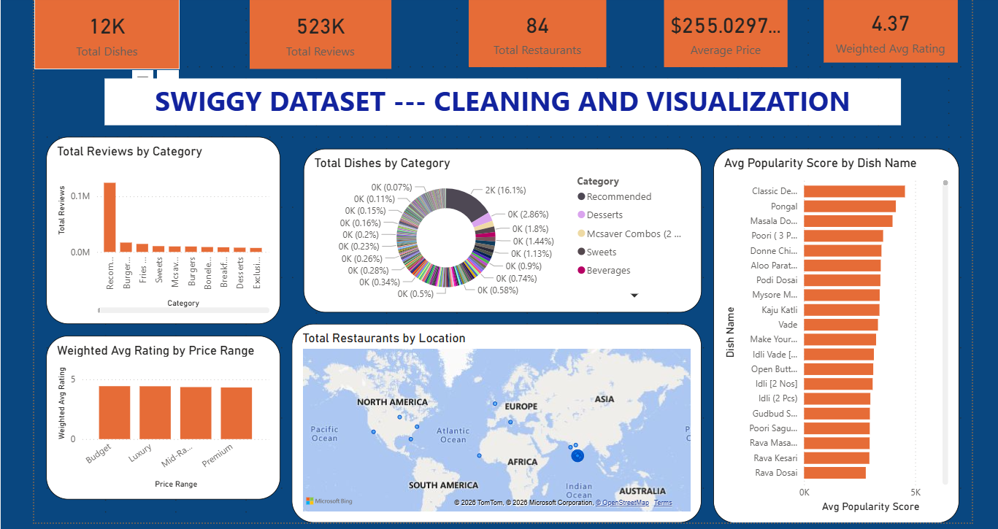
DATA VISUALIZATION – OVERVIEW

Slide 8
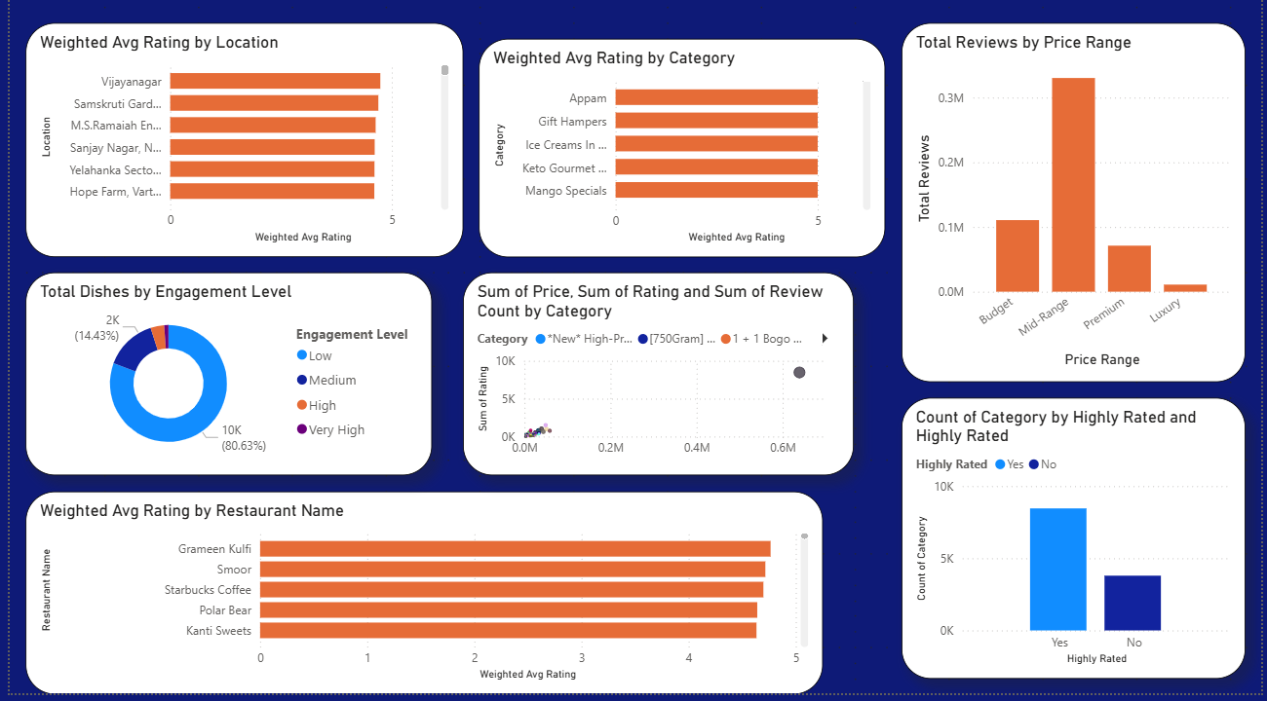
DATA VISUALIZATION – OVERVIEW

Slide 9
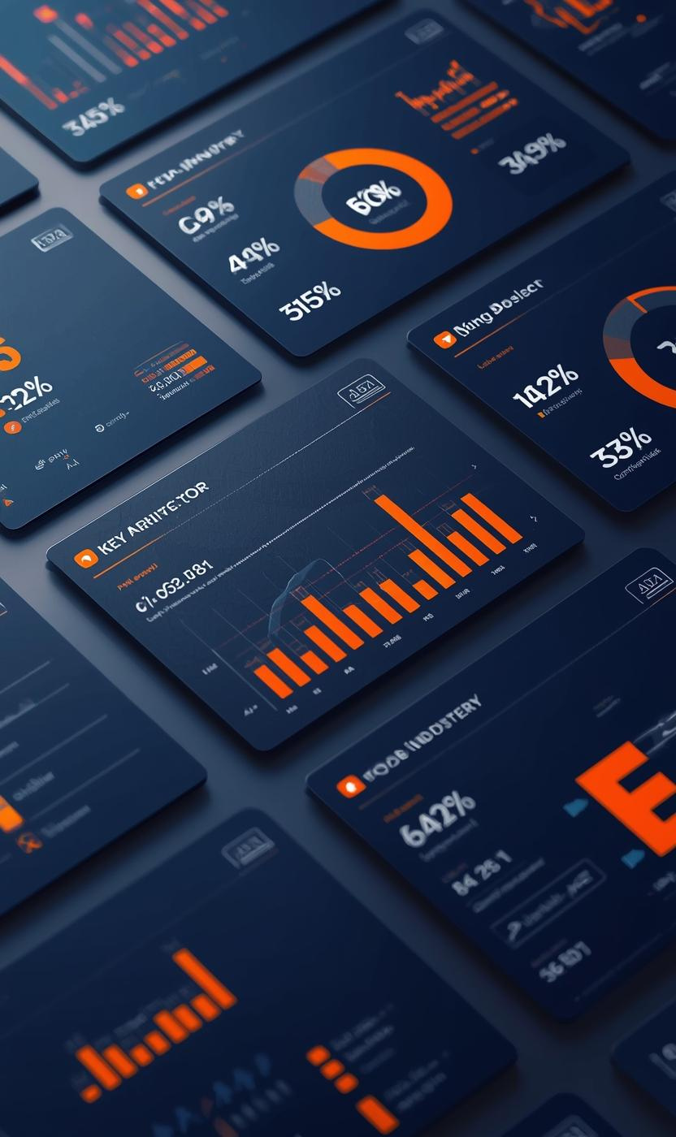
Dashboard Components
KPI Cards (Total Dishes, Reviews, Avg Rating, Avg Price)
Category performance charts
Price vs Rating comparison
Location performance map
Weighted rating by price range
Highly Rated classification
Key Insights
Budget and Mid-Range products dominate engagement.
Overall weighted rating is strong (~4.3+).
High-rated dishes represent majority of products.

Slide 10
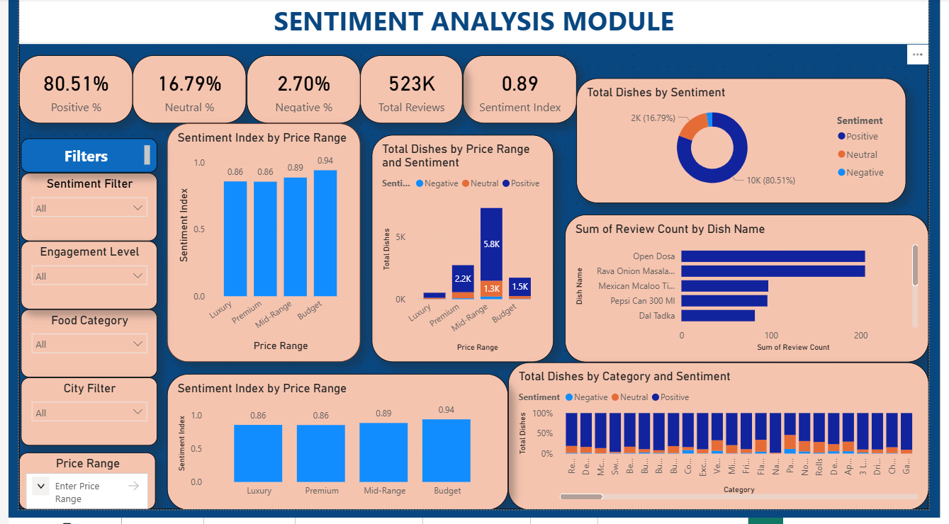
SENTIMENT ANALYSIS MODULE

Slide 11
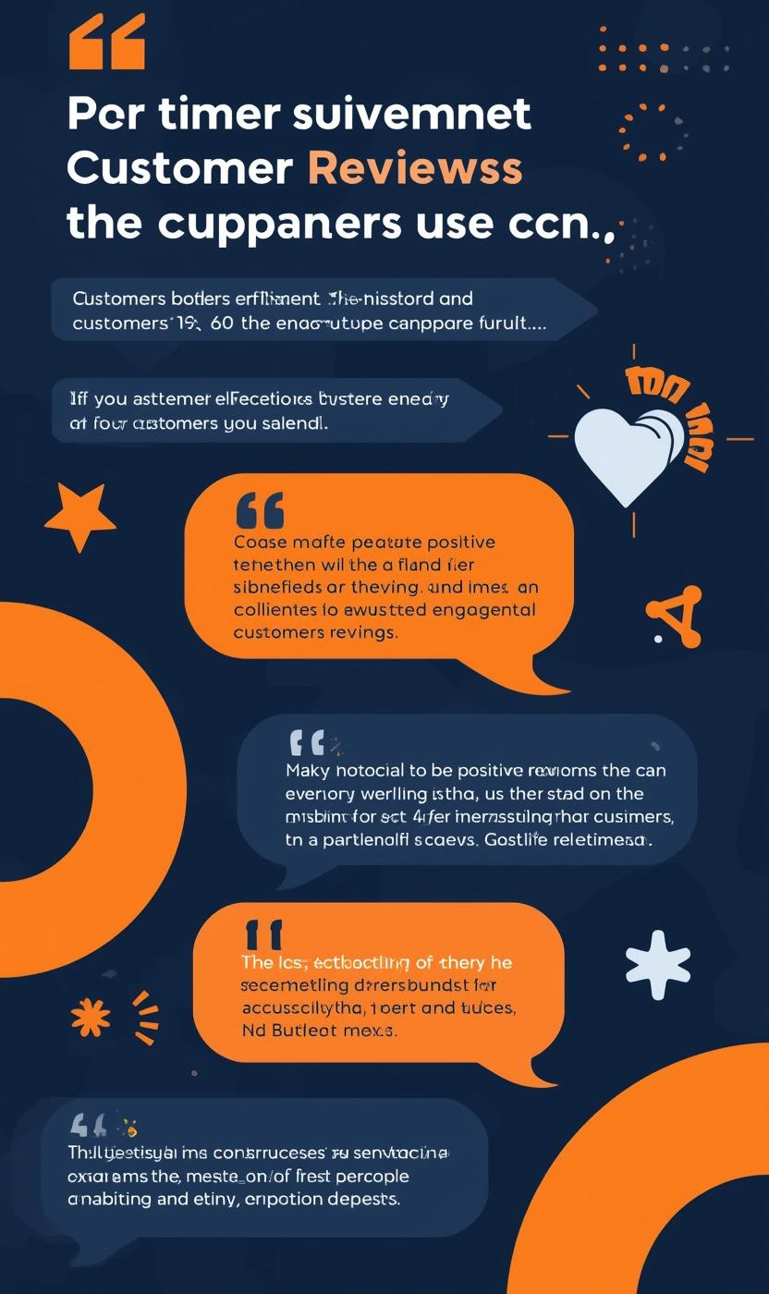
SENTIMENT CONVERSION LOGIC
RATINGS WERE CONVERTED INTO SENTIMENT CATEGORIES:
POSITIVE (≥ 4)
NEUTRAL (3–3.9)
NEGATIVE (< 3)
A WEIGHTED SENTIMENT INDEX WAS CALCULATED TO MEASURE OVERALL EMOTIONAL STRENGTH.
SENTIMENT DASHBOARD KPIS
POSITIVE SENTIMENT: 80.51%
NEUTRAL SENTIMENT: 16.79%
NEGATIVE SENTIMENT: 2.70%
TOTAL REVIEWS: 523K
SENTIMENT INDEX: 0.89

Slide 12
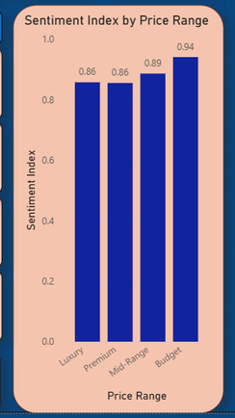
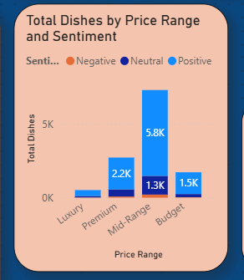
Sentiment Analysis by Pricing Strategy
BUDGET PRICING INSIGHTS
The budget segment shows the highest sentiment index, reflecting strong customer satisfaction and positive engagement, driving repeat purchases and loyalty.
PREMIUM & LUXURY INSIGHTS
Premium and luxury segments exhibit lower sentiment indices compared to budget offerings, indicating potential areas for improvement in customer response strategies.
BUDGET TIER SHOWS HIGHEST SENTIMENT INDEX (~0.94)
PREMIUM & LUXURY SLIGHTLY LOWER (~0.86)
EMOTIONAL STRENGTH STRONGEST IN AFFORDABLE SEGMENT

Slide 13
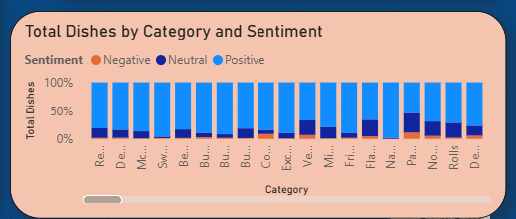
Sentiment Distribution by Category
RISK IDENTIFICATION
Analyzing sentiment across categories reveals trends, indicating potential risk areas where customer satisfaction may be declining significantly.
OPPORTUNITY AREAS
Identifying categories with high engagement can highlight opportunity areas for product innovation and marketing strategies to better meet customer needs.
MOST CATEGORIES DOMINATED BY POSITIVE SENTIMENT
VERY SMALL NEGATIVE SHARE ACROSS CATEGORIES
SOME CATEGORIES SHOW MODERATE NEUTRAL PROPORTIONS

Slide 14
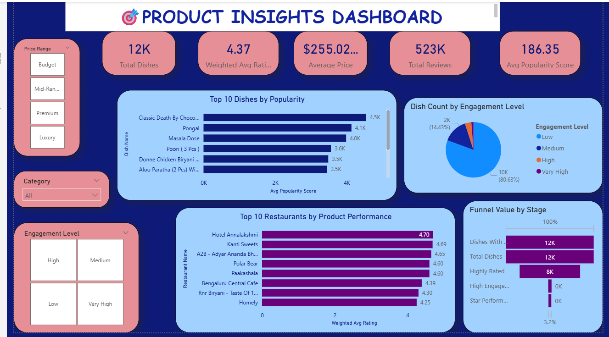
PRODUCT INSIGHTS MODULE

Slide 15
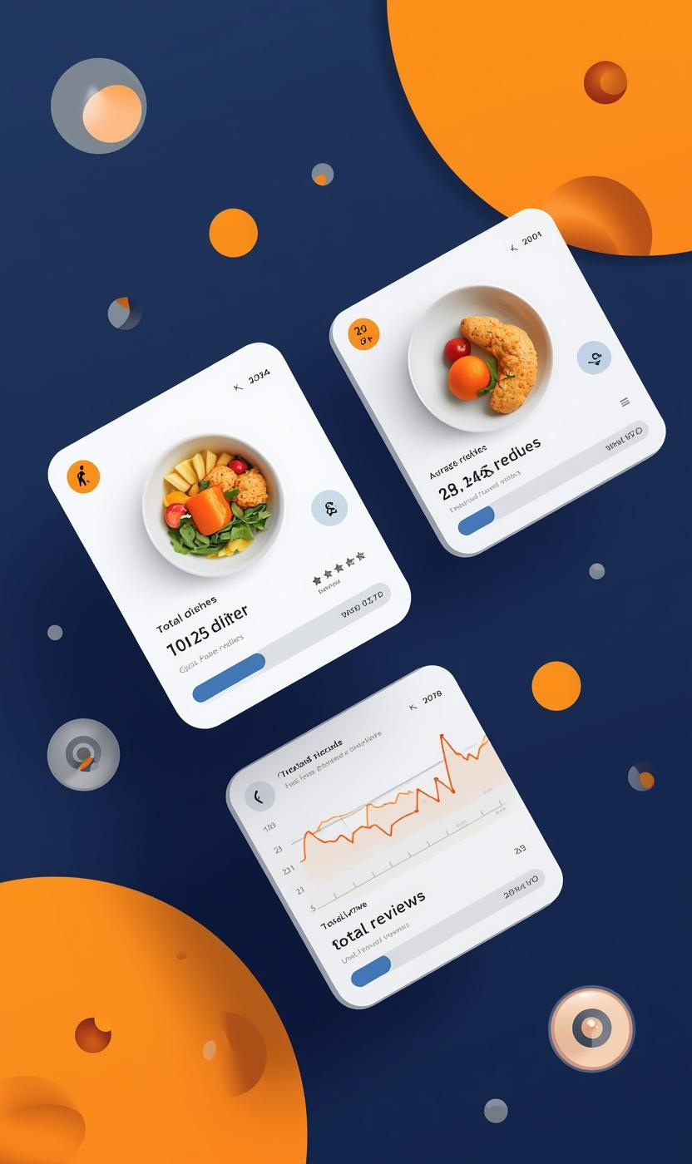
EXECUTIVE KPIS
TOTAL DISHES: 12K
WEIGHTED AVG RATING: 4.37
AVERAGE PRICE: ₹255
TOTAL REVIEWS: 523K
AVG POPULARITY SCORE: 186.35
CUSTOMER SATISFACTION
Our analysis shows strong customer satisfaction, indicating that customers feel valued and appreciated in their interactions with our platform.
ENGAGEMENT ALIGNMENT
Engagement levels are positively correlated with sentiment, suggesting that effective strategies are in place to enhance user experience and loyalty.

Slide 16
Top Performing Dishes
POPULARITY INSIGHTS
The top 10 dishes by popularity highlight customer preferences, showcasing high engagement and market favorites in the food business.
ENGAGEMENT METRICS
TOP 10 DISHES BY POPULARITY
HIGH-PERFORMING DISHES COMBINE:
HIGH RATING
HIGH ENGAGEMENT
POPULAR TRADITIONAL AND DESSERT ITEMS DOMINATE RANKINGS.
These dishes not only attract significant attention but also demonstrate strong engagement levels, representing lucrative opportunities for strategic marketing efforts.

Slide 17
Restaurant Performance Insights
TOP RESTAURANTS
The analysis reveals the top-performing restaurants based on weighted ratings, showcasing their strengths and areas for improvement in customer satisfaction.
COMPETITIVE BENCHMARKING
TOP RESTAURANTS BY WEIGHTED RATING
RESTAURANTS MAINTAINING CONSISTENT HIGH RATINGS:
HOTEL ANNALAKSHMI
KANTI SWEETS
A2B
POLAR BEAR
A comparison against industry standards helps identify market leaders while providing insights into competitive positioning and strategies for growth.

Slide 18
Product Performance Funnel Analysis
OVERVIEW OF RATINGS
The funnel illustrates the journey from total dishes to highly rated options, highlighting the critical path to customer engagement.
ENGAGEMENT METRICS
Analyzing this progression, we identify star performers that maximize customer interaction and drive profitability in our offerings.
FUNNEL STAGES
TOTAL DISHES: 12K
DISHES WITH REVIEWS
HIGHLY RATED: 8K
HIGH ENGAGEMENT
STAR PERFORMERS

Slide 19
Engagement Levels and Insights
LOW ENGAGEMENT
Approximately 80% of products exhibit low customer engagement, indicating potential areas for improvement in marketing strategies and customer outreach.
HIGH ENGAGEMENT
A small cluster of products shows high engagement, representing key opportunities to promote these items and enhance overall customer interest.
MAJORITY OF DISHES FALL UNDER LOW ENGAGEMENT.
SMALL PORTION REACHES HIGH OR VERY HIGH ENGAGEMENT.

Slide 20
Overall Impact
DATA CLEANING & MODELING
Comprehensive data cleaning and modeling increased data reliability, ensuring robust insights that drive informed decision-making for businesses in the food industry.
BI DASHBOARD DESIGN
The developed BI dashboard presents key metrics and sentiments effectively, empowering stakeholders to visualize data and make strategic business adjustments promptly.

Slide 21


Thank You for Your Attention
BY
DEEKSHITHA KAMMULA

